Slide 1
Project 2: Instruction
Dr. Jim La
University of Nevada Reno

Slide 2
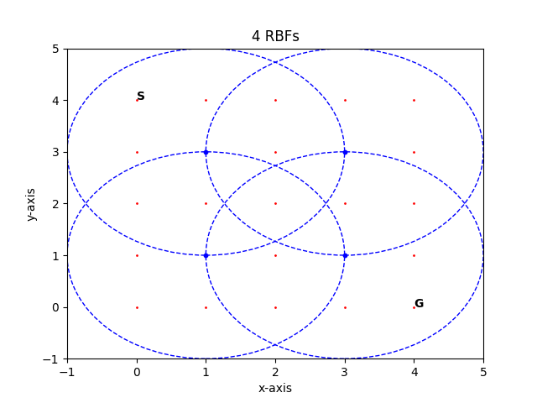
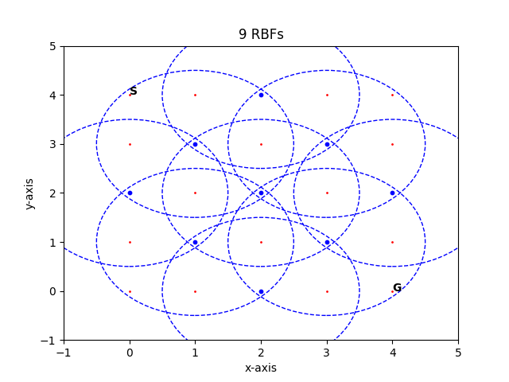
Project 2
The problem is the same as Project 1. Using Radial Basis Functions (RBF) to approximate the state space. You can use 4 RBF to approximate the state space. Something is similar to these figures.

Slide 3
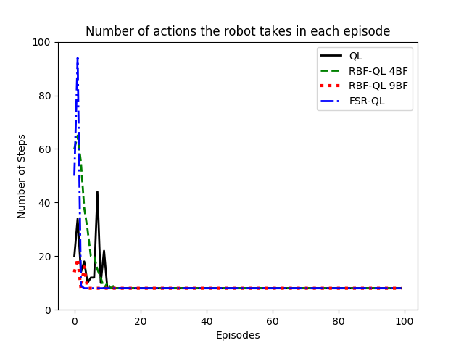
1. (UG: 50 points, G: 40 points) Plot the number of actions the robot takes in each episode for normal Q learning (QL), RBF-QL with 4BF, and RBF-QL with 9BF

Slide 4
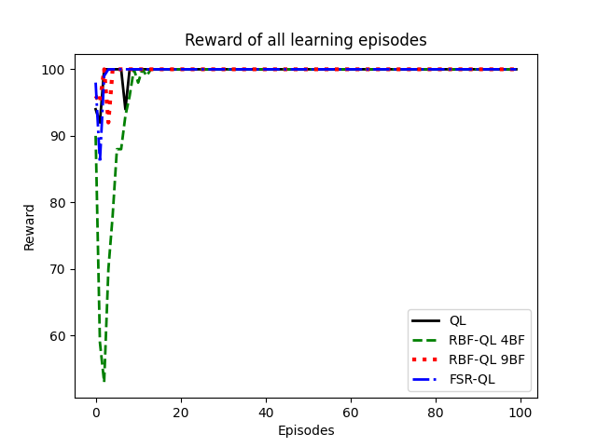
2. (UG: 50 points, G: 40 points) Plot the reward of all learning episodes for each method: Q learning (QL), RBF-QL with 4BF, and RBF-QL with 9BF.

Slide 5
3. (Grad: 20 points) For Grad students (CPE671 only): Implement the FSR and plot its results to compare to the RBF-QL with 9BF. Undergrad students are welcome to implement this FSR with +10 points bonus.

Slide 6
Code: Python
import numpy as np
import matplotlib.pyplot as plt
import random
import math

Slide 7
Code: Normal Q learning
# functions for normal QL
def choose_action_QL_normal(s,Q_table,epsilon,p_array,iteration):
# select the action with highest estimated action value
# if several actions with same Q value: randomize
# get maximum value
max_action_value = max(Q_table[s].values())
# get all keys with maximum value
max_action_keys = [key for key,value in Q_table[s].items() if value == max_action_value]
# decaying epsilon. Higher epsilon at start of training for more exploration. In later episodes uses exploitation.
if episode == 0 or episode == 1:
epsilon = 0.5
elif episode < 10:
epsilon = 0.01
else:
epsilon = 0.0
p = p_array[iteration]
if p >= epsilon:
# if more than one maximum value action found
if len(max_action_keys) > 1:
# randomize
action = random.choice(max_action_keys)
else:
action = max_action_keys[0]
else:
# randomize
action = random.choice(list(Q_table[s]))
return action

Slide 8
Action selection: Normal Q Learning
def take_action_QL_normal(action, s):
# set new state s'
if action == 'up':
sprime = (s[0]-1, s[1])
if action == 'down':
sprime = (s[0]+1, s[1])
if action == 'left':
sprime = (s[0], s[1]-1)
if action == 'right':
sprime = (s[0], s[1]+1)
# set reward r
# • Action that makes the robot tend to go out of the grid will get a reward of -1 (when the robot is in the border cells)
# • Action that makes the robot reach the goal will get a reward of 100
# • All other actions will get a reward of 0
if sprime == (4,4):
r = 100
elif sprime[0] == -1 or sprime[1] == -1 or sprime[0] == 5 or sprime[1] == 5:
r = -1
else:
r = 0
# if action would be out of the border, robot stays in current cell
if r == -1:
sprime = s
return r, sprime

Slide 9
Q Learning Function
def QL_normal(gamma, alpha, epsilon, p_array, s, Q_table):
reward_sum_episode_QL_normal = 0
action_sum_episode_QL_normal = 0
iteration = 0
iteration_terminate = 0
""" Repeat (for each step of episode): """
# while loop until goal is reached
while s != (4,4) and iteration_terminate < 10000:
""" Choose a from s using policy derived from Q (e.g. epsilon-greedy) """
action = Your code is here …
""" Take action a, observe r,s' """
r, sprime = Your code is here …
""" Q[s,action] += alpha * (reward + (gamma * predicted_value) - Q[s,action]) """
predicted_value = Your code is here …
Q_table[s][action] += Your code is here …
action_sum_episode_QL_normal += 1
reward_sum_episode_QL_normal += r
if iteration < 199:
iteration += 1
else:
iteration = 0
iteration_terminate += 1
""" s = s' """
s = sprime
""" Until s is terminal """
return action_sum_episode_QL_normal, reward_sum_episode_QL_normal

Slide 10
Action Selection Function for RBF-QL with 4RBF
def choose_action_4RBF(s,theta,epsilon,p_array,c,mu,iteration):
# select the action with highest estimated action value
# if several actions with same value: randomize
# calculate phi for all actions
phi_all_actions = []
# for all 4 actions
for i in range(4):
phi = np.zeros(16)
for l in range(4):
phi[i*4+l] = Your code is here … (using Gaussian function described in the lecture)
phi_all_actions.append(phi)
# calculate phi_transp*theta for each action
phi_t_mult_theta_list = []
for phi in phi_all_actions:
phi_t_mult_theta_list.append(phi@theta)
max_action_keys = [jj for jj, j in enumerate( phi_t_mult_theta_list ) if j == max( phi_t_mult_theta_list )]
# decaying epsilon. Higher epsilon at start of training for more exploration. In later episodes uses exploitation.
if episode == 0 or episode == 1:
epsilon = 0.5
elif episode < 10:
epsilon = 0.01
else:
epsilon = 0.0
p = p_array[iteration]
if p >= epsilon:
# if more than one maximum value action found
if len(max_action_keys) > 1:
# randomize
action = random.choice(max_action_keys)
else:
action = max_action_keys[0]
else:
# randomize
action = random.randint(0, 3)
return action

Slide 11
Take action
def take_action_4RBF(action, s):
# set new state s'
if action == 0:
sprime = (s[0]-1, s[1])
if action == 1:
sprime = (s[0]+1, s[1])
if action == 2:
sprime = (s[0], s[1]-1)
if action == 3:
sprime = (s[0], s[1]+1)
# set reward r
# • Action that makes the robot tend to go out of the grid will get a reward of -1 (when the robot is in the border cells)
# • Action that makes the robot reach the goal will get a reward of 100
# • All other actions will get a reward of 0
if sprime == (4,4):
r = 100
elif sprime[0] == -1 or sprime[1] == -1 or sprime[0] == 5 or sprime[1] == 5:
r = -1
else:
r = 0
# if action would be out of the border, robot stays in current cell
if r == -1:
sprime = s
return r, sprime

Slide 12
Q Learning 4RBF
def QL_4RBF(gamma, alpha, epsilon, p_array, s, c, mu, theta):
reward_sum_episode_4RBF = 0
action_sum_episode_4RBF = 0
iteration = 0
iteration_terminate = 0
""" Repeat (for each step of episode): """
# while loop until goal is reached
while s != (4,4) and iteration_terminate < 10000:
""" Choose a from A using greedy policy with probability p """
action = choose_action_4RBF(s,theta,epsilon,p_array,c,mu,iteration)
""" Take action a, observe r,s' """
r, sprime = take_action_4RBF(action, s)
""" Estimate phi_s """
phi_s = np.zeros(16)
for i in range(4):
if action == i:
for l in range(4):
phi_s[i*4+l] = math.exp( - (np.linalg.norm( s - c[l,:])**2 ) /(2*(mu[l]**2)) )
""" Update """
# calculate predicted value
# calculate phi_sprime for all actions
phi_sprime_all_actions = []
# for all 4 actions
for i in range(4):
phi_sprime = np.zeros(16)
for l in range(4):
phi_sprime[i*4+l] = Your code is here … using Gaussian function
phi_sprime_all_actions.append(phi_sprime)
# calculate phi_sprime_transp*theta for each action
phi_sprime_t_mult_theta_list = []
for phi_sprime in phi_sprime_all_actions:
phi_sprime_t_mult_theta_list.append(phi_sprime@theta)
predicted_value = max(phi_sprime_t_mult_theta_list)
# theta update
theta += Your code is here …
action_sum_episode_4RBF += 1
reward_sum_episode_4RBF += r
if iteration < 199:
iteration += 1
else:
iteration = 0
iteration_terminate += 1
""" s = s' """
s = sprime
""" Until s is terminal """
return action_sum_episode_4RBF, reward_sum_episode_4RBF

Slide 13
Action Selection FSR
def choose_action_FSR(s,theta,epsilon,p_array,iteration):
# select the action with highest estimated action value
# if several actions with same Q value: randomize
# calculate phi for all actions
phi_all_actions = []
# for all 4 actions
for i in range(4):
phi = np.zeros(40)
for l in range(10):
# dimension x
Your code is here …
# dimension y
Your code is here …
phi_all_actions.append(phi)
# calculate phi_transp*theta for each action
phi_t_mult_theta_list = []
for phi in phi_all_actions:
phi_t_mult_theta_list.append(phi@theta)
# calculate argmax phi_transp*theta
max_action_keys = [jj for jj, j in enumerate( phi_t_mult_theta_list ) if j == max( phi_t_mult_theta_list )]
# decaying epsilon. Higher epsilon at start of training for more exploration. In later episodes uses exploitation.
if episode == 0 or episode == 1:
epsilon = 0.5
elif episode < 10:
epsilon = 0.01
else:
epsilon = 0.0
p = p_array[iteration]
if p >= epsilon:
# if more than one maximum value action found
if len(max_action_keys) > 1:
# randomize
action = random.choice(max_action_keys)
else:
action = max_action_keys[0]
else:
# randomize
action = random.randint(0, 3)
return action

Slide 14
Take action FSR
def take_action_FSR(action, s):
# set new state s'
if action == 0:
sprime = (s[0]-1, s[1])
if action == 1:
sprime = (s[0]+1, s[1])
if action == 2:
sprime = (s[0], s[1]-1)
if action == 3:
sprime = (s[0], s[1]+1)
# set reward r
# • Action that makes the robot tend to go out of the grid will get a reward of -1 (when the robot is in the border cells)
# • Action that makes the robot reach the goal will get a reward of 100
# • All other actions will get a reward of 0
if sprime == (4,4):
r = 100
elif sprime[0] == -1 or sprime[1] == -1 or sprime[0] == 5 or sprime[1] == 5:
r = -1
else:
r = 0
# if action would be out of the border, robot stays in current cell
if r == -1:
sprime = s
return r, sprime

Slide 15
Q Learning FSR
def QL_FSR(gamma, alpha, epsilon, p_array, s, theta):
reward_sum_episode_FSR = 0
action_sum_episode_FSR = 0
iteration = 0
iteration_terminate = 0
""" Repeat (for each step of episode): """
# while loop until goal is reached
while s != (4,4) and iteration_terminate < 10000:
""" Choose a from A using greedy policy with probability p """
action = choose_action_FSR(s,theta,epsilon,p_array,iteration)
""" Take action a, observe r,s' """
r, sprime = take_action_FSR(action, s)
""" Estimate phi_s """
phi_s = np.zeros(40)
for i in range(4):
# length 10
if action == i:
for l in range(10):
# dimension x
Your code is here …
# dimension y
Your code is here …
""" Update """
# calculate predicted value # calculate phi_sprime for all actions
phi_sprime_all_actions = []
# for all 4 actions
for i in range(4):
phi_sprime = np.zeros(40)
for l in range(10):
# dimension x
Your code is here …
# dimension y
Your code is here …
phi_sprime_all_actions.append(phi_sprime)
# calculate phi_sprime_transp*theta for each action
phi_sprime_t_mult_theta_list = []
for phi_sprime in phi_sprime_all_actions:
phi_sprime_t_mult_theta_list.append(phi_sprime@theta)
predicted_value = max(phi_sprime_t_mult_theta_list)
# theta update
theta += alpha * (r + (gamma * predicted_value) - phi_s@theta) * phi_s
action_sum_episode_FSR += 1
reward_sum_episode_FSR += r
if iteration < 199:
iteration += 1
else:
iteration = 0
iteration_terminate += 1
""" s = s' """
s = sprime
""" Until s is terminal """
return action_sum_episode_FSR, reward_sum_episode_FSR
if __name__=="__main__":

